Slide 1
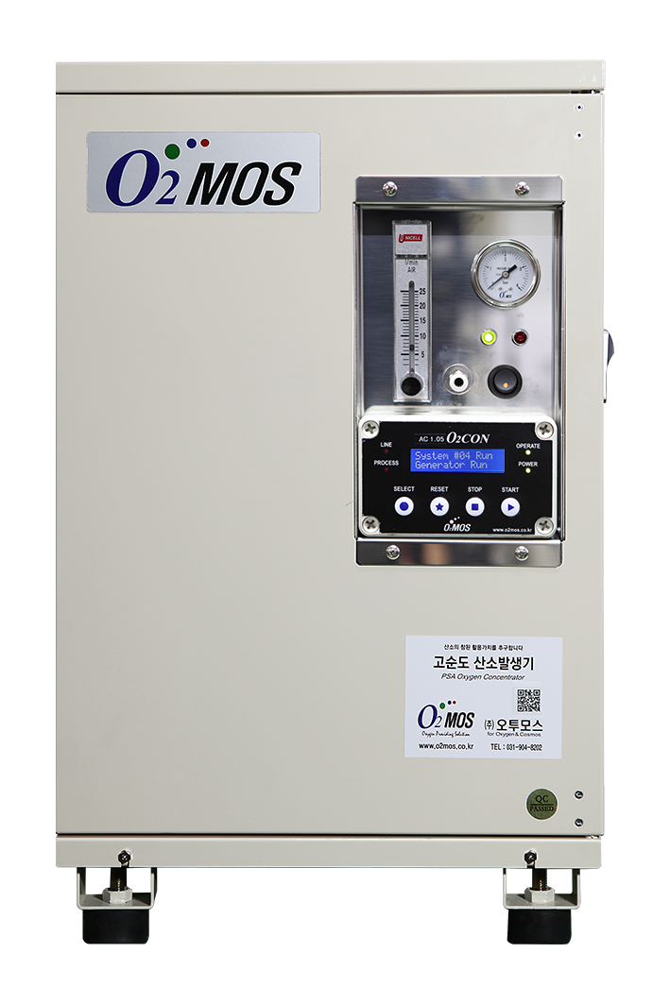
Smart PSA Oxygen Generator
The New Standard — WiFi-Connected · 6-Parameter Real-Time Monitoring
✓ 7 LPM / 90% Purity / 1.5 bar Discharge Pressure
✓ 📶 Built-in WiFi per unit — remote access, Web, App Monitoring
✓ 6-Parameter live monitoring: Purity · Flow · Pressure · Temperature
✓ Configurable alerts · Trend graphs · CSV export · Cloud optional
✓ Standard Boost expansion → up to 35 LPM · Each unit independently monitored
Contact Us Today | Start Your Smart Aquaculture Journey

Slide 2
Oxygen Supply Determines Life & Death in Fish Farming
WHY OXYGEN MANAGEMENT IS CRITICAL IN AQUACULTURE
DO below 4 mg/L → Fish stress & stunted growth | DO below 2 mg/L → Acute mass mortality risk
💀
Mass Mortality
📉
Growth Impairment
💸
Soaring Op-Costs
#1 Cause of Farm Loss
DO drop → Growth rate –30%
Liquid O₂ dependency costs surge
O₂ failure → total stock loss within hours
Irreversible economic damage
Average loss: $50K–$500K per incident
Low DO reduces feed intake
Weakens immunity, raises disease risk
Yield & product quality both decline
Supply disruption risk
Rising transport & storage costs
Operational uncertainty year-round
Our on-site PSA Oxygen Generator with built-in WiFi monitoring fundamentally solves all of these challenges.

Slide 3
We pursue the true value of oxygen.
Oxygen Technology
Smart PSA High-Purity Oxygen Concentrator
Model: O2MOS-7LC-K
Remote Management System Compatible
Product Overview
Using only electricity, this unit separates and produces oxygen at concentrations of 90% or higher from ambient air (21% O2) via PSA (Pressure Swing Adsorption) technology. Performance and status are monitored digitally in real time. Remote control via internet and predictive maintenance are supported.
⚡ PSA Technology
📡 Remote Monitoring
🔬 ≥ 90% Purity
🛡 Predictive Maintenance
Parameter | Specification | Notes / Features
Product Name | Smart High-Purity Oxygen Concentrator | Remote Management System Compatible
Model | O2MOS-7LC-K
O₂ Flow / Concentration | 7 LPM / ≥ 90% | No-load flow (initial set): 9 LPM standard
Status Monitoring — Standard | Process pressure / Supply pressure / Operating temperature / Voltage status / O₂ flow rate / O₂ concentration
Status Monitoring — Option | Digital O₂ flow rate / O₂ concentration
O₂ Supply Pressure | Max. 1.3 bar
O₂ Outlet Connection | 6 mm one-touch fitting | Polyurethane tube standard
Front Panel Display | Controller monitor / Power switch / Discharge pressure gauge / O₂ flow gauge / O₂ outlet
Power Consumption | Avg. ≤ 480 W (220 VAC / 60 Hz) | 3C × 0.75 mm² / 2 m / grounding plug
Dimensions (W×D×H) / Weight | 355 × 375 × 578 mm / 27 kg | Height includes rubber feet
Enclosure Material | Body frame: Steel | Case body: Aluminum | Beige powder coating
Operating Temperature | Normal operating: 0 °C – 40 °C

Slide 4
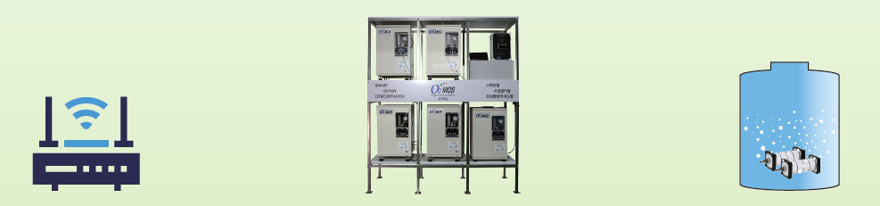
Key Monitored Parameters — Why Every One Matters
Real Time Monitoring & Control
• Remote monitoring of oxygen purity → Quality Control
• Real-Time Oxygen Flow Monitoring → Ensures Stable Oxygen Supply
• Discharge Pressure Monitoring → Early Fault Detection
• Temperature of PSA Oxygen Generator
• Process Pressure of Oxygen Generator
• Total Operation Time
• Current Voltage Status
→ Smart Oxygen Monitoring System
Real Time Monitoring & Control
Tank w/ dissolved Oxygen
Gateway
Conventional oxygen generators only produce oxygen. O2MOS manages oxygen production and its operating status in real time.

Slide 5
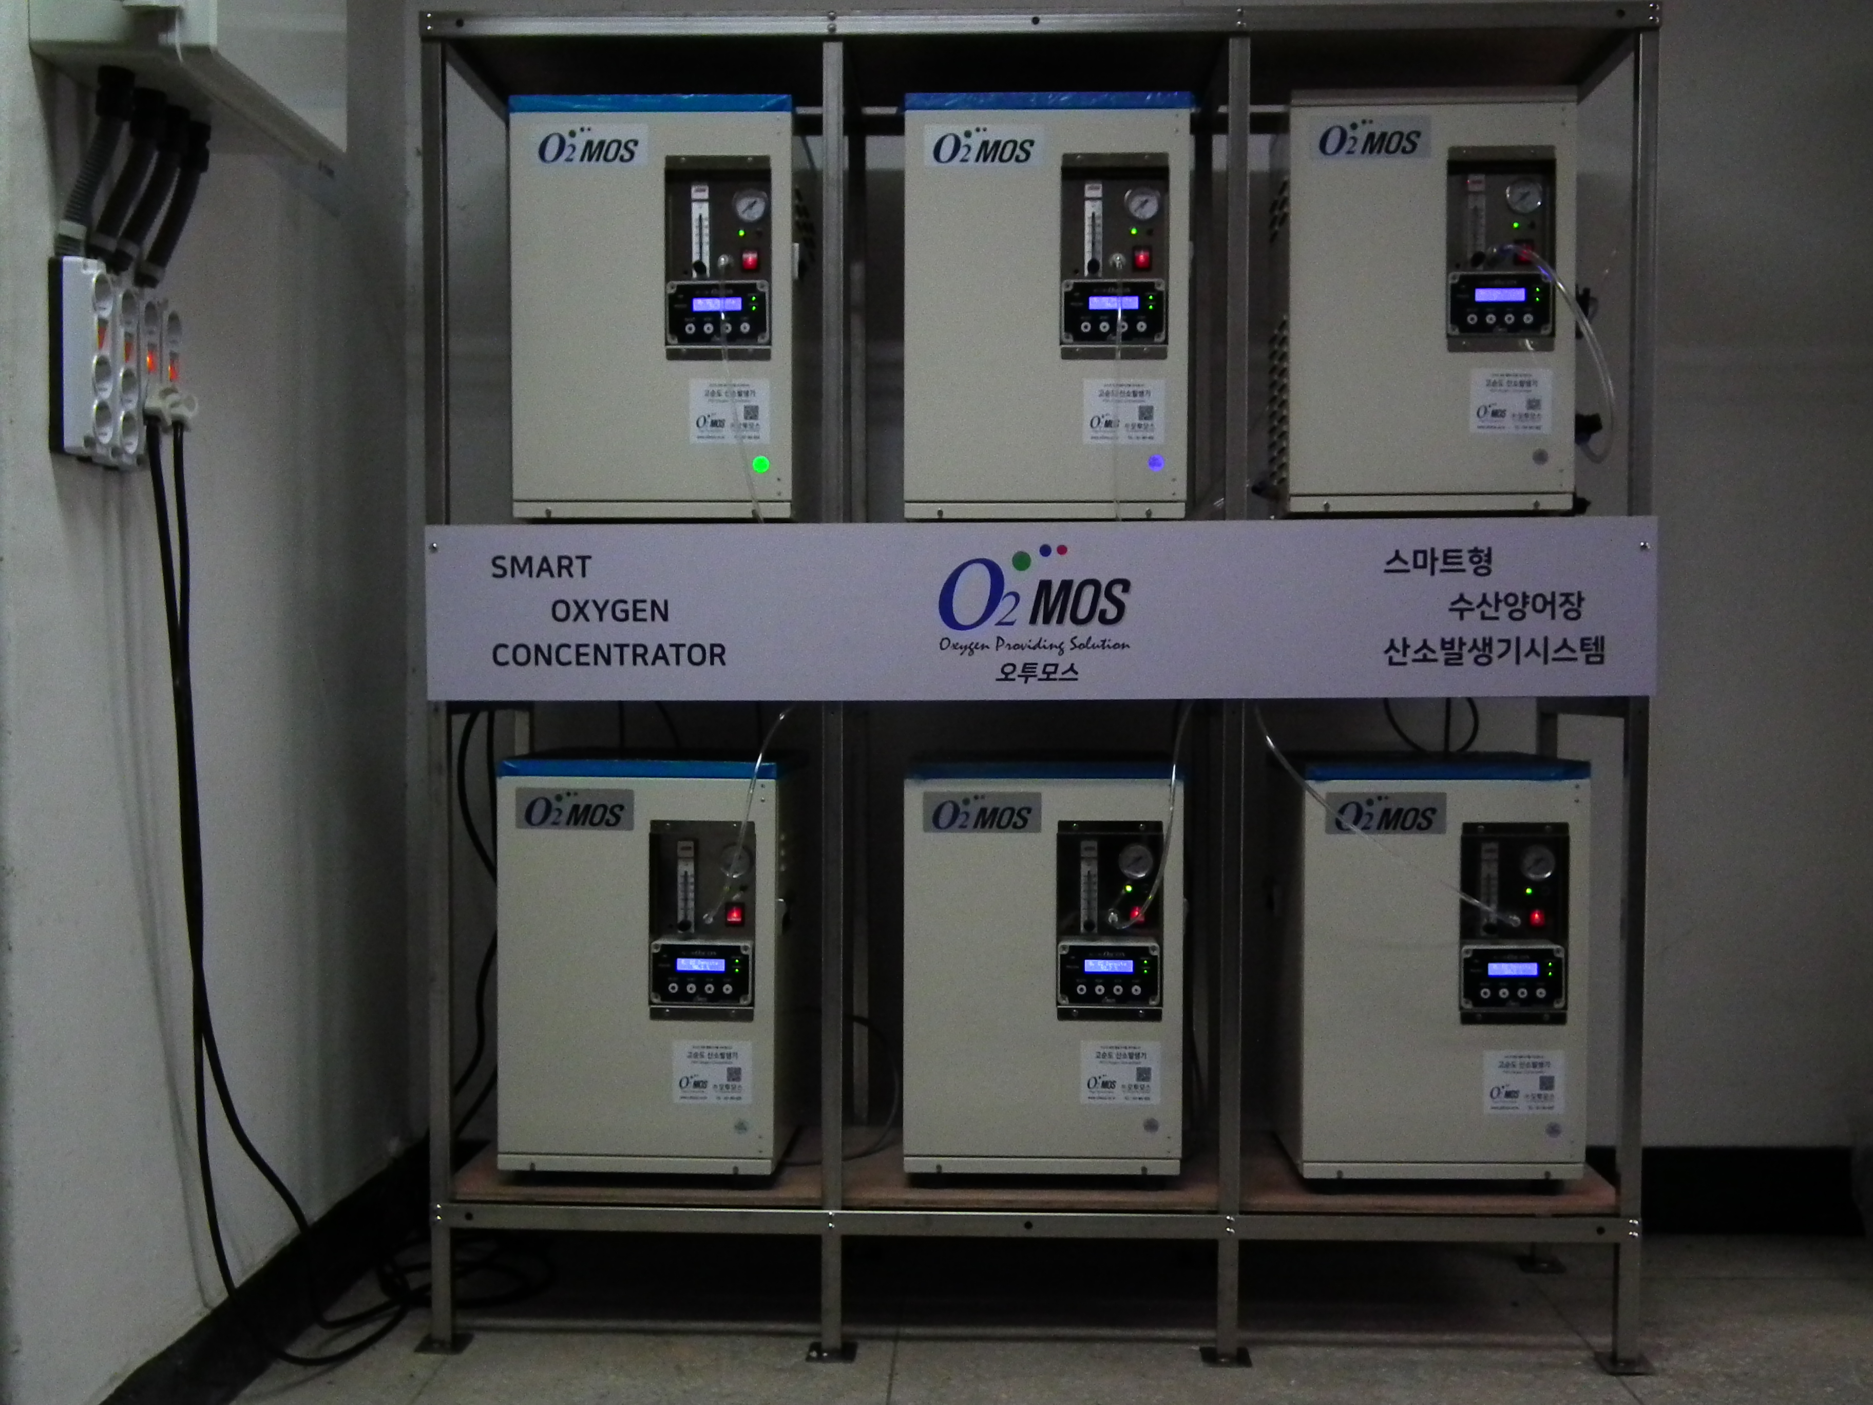
Smart Oxygen Generator System— Large-Scale
Smart Oxygen Supply Rack | Standard configuration (6 units)
Multiple PSA Generators in Parallel | Up to 6 units (42 LPM) Individual Oxygen Generator Performance & Operation Monitoring
Pressure Booster | For use with pressures above 1.5 bar Integrated monitoring of flow, oxygen purity, and pressure
Smart Monitor | Integrated management of system operating status System operation history check
Gateway | Remote monitoring of system status Remote management shared with customer service
NEO2 Program | Remote monitoring, fault analysis, and field issue resolution

Slide 6
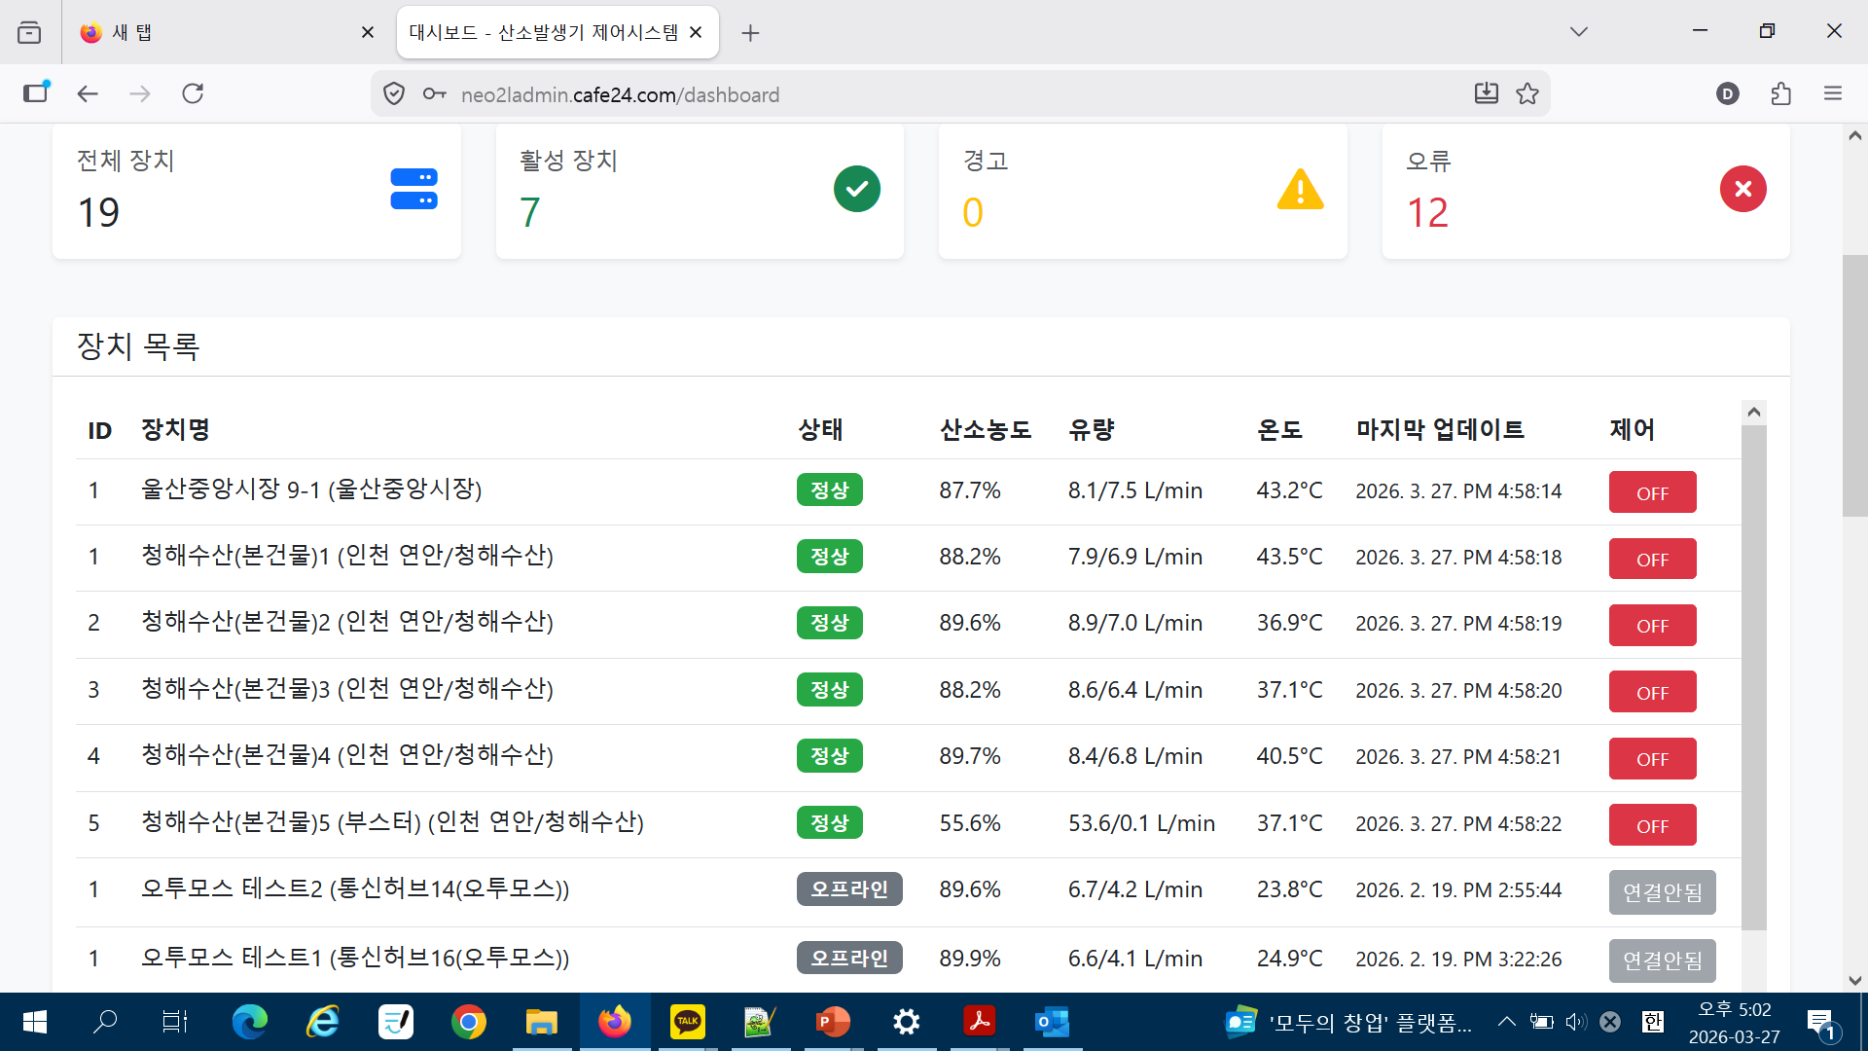
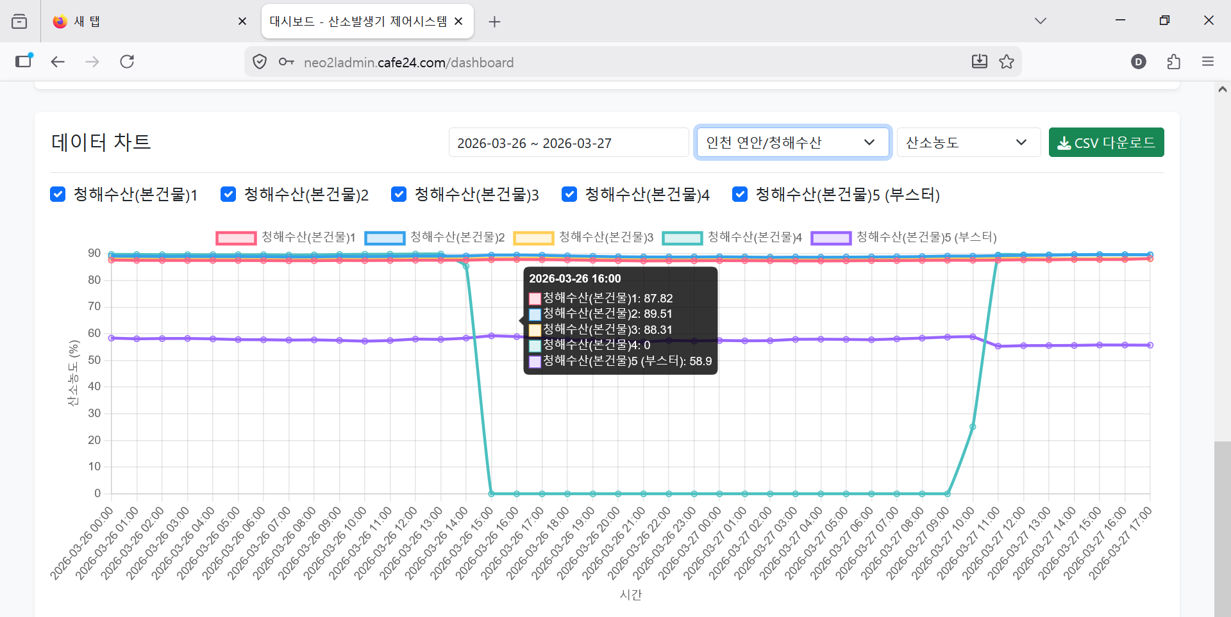
Our Differentiation — World-Class WiFi Smart Monitoring
HOW WE STAND APART: BUILT-IN WIFI + 6-PARAMETER LIVE MONITORING
Competitor Comparison
Feature
Ours
Typical
Built-in WiFi Per Unit
✅
❌
O₂ Purity Remote Monitor
✅
❌
Flow Rate Real-time Monitor
✅
△ Partial
Pressure Remote Monitor
✅
❌
Temperature Real-time Monitor
✅
❌
6-Parameter Live Dashboard
✅
❌
Root Cause Analysis
✅
❌
Boost status Remote Monitor
✅
❌
Built-in WiFi + 6-Parameter Real-Time Monitoring = The only complete smart aquaculture O₂ solution

Slide 7
Summary of Key Features
📶
Built-in WiFi Per Unit
Each PSA unit has its own WiFi Connect via browser — no app, no hub Instant live dashboard on any device
📊
6-Parameter Live Monitor
Purity · Flow · Pressure · Temperature, Voltage, Process Pressure. All refreshed in real time via WiFi. Threshold alerts configurable per param
🔍
Root Cause Instant Diagnosis
Tells you not just 'something's wrong’ but which parameter failed and why Data-driven corrective action guidance
🔗
Boost Expansion — Any Scale
Up to 5 units in parallel → 35 LPM, Each unit independently WiFi-monitored. All units visible on one dashboard

Slide 8
“Smart Oxygen Control –Safe, Efficient, and Always Connected”
The Smart Oxygen Generation System brings value and benefits to everyone involved.
Aquaculture Farm | Equipment Supplier and After-Sales Service Provider
Accurately checks oxygen supply status for safe operation | Reduces dispatch and labor costs through remote equipment management and quick response.
Predicts and manages potential risks in advance | Collaborative preventive management minimizes unplanned repair expenses and prevents customer disputes.
Easy status sharing and troubleshooting with the equipment provider | Pre-diagnostic information can be reviewed and prepared before regular inspections, reducing inspection labor costs and enabling data sharing with customers.
Minimizes maintenance costs by taking preventive measures before equipment failure | Builds strong trust with customers, contributing to business success.

